Slide 1
CSE 3411 System Analysis and Design (SAD) Spring 2024
Dr. Suman Ahmmed
Sumayra Islam
Abtahi Ahmed

Slide 2
Software Requirement Specifications

Slide 3
SRS
A complete specification and description of requirements of the software that need to be fulfilled for the successful development of the software system.
Generated as output of Requirements Analysis.
A formal report that enables the customers to review whether it is according to their requirements.

Slide 4
Structural Components of an SRS
Purpose – Main aim of why the document is necessary
Scope – Overall working and main objective of document and what value it will provide to customer is described
Overview – Description of product is explained

Slide 5
Structural Components of an SRS
Functional Requirements — Specify the expected behavior of the system - which outputs should be produced from the given inputs. — Include technical details, calculations, data processing, etc.
Interface Requirements — How software program communicates with each other or users either in form of any language, code, or message. — Shared memory, data streams, etc.

Slide 6
Structural Components of an SRS
Performance Requirements — How a software system performs desired functions under specific conditions — Required time, required memory, maximum error rate, etc.
Design Constraints — Limitations or restrictions are specified — Particular algorithm, hardware and software limitations, etc.
Preliminary Schedule & Budget

Slide 7
Structural Components of an SRS
Non-Functional Attributes — Attributes for better performance — Reusability, Application Compatibility, Data Integrity, Scalability, etc. — Operational Requirements (portability, maintainability) — Performance Requirements (speed, capacity) — Security Requirements (digital certificate, access control, reliability) — Cultural and Political Requirements (social, language, legal, unstated norms etc.)

Slide 8
Uses of an SRS
Project manager base their plans and estimates of schedule, effort and resources on it.
Development team require it for developing product according to the need.
Test plans are generated by testing group based on the describe external behaviour.
Maintenance and support staff need it to understand what the software product is supposed to do.

Slide 9
Uses of an SRS
Customers rely on it to know that product they can expect.
As a contract between developer and customer.
Publications group writes documents, manuals, etc.
Training personnel can use it to help develop educational material.

Slide 10
Validation of an SRS Document
It is extremely important to detect errors in the SRS document before going to other phases.
The major objective of SRS validation is to ensure Completeness and Correctness.

Slide 11
Validation of an SRS Document
In validation checking phase, we have to avoid the following errors:
1. Omission: Some user requirement is not included in the SRS. This error directly affects the external completeness of the system.
2. Inconsistency: Due to contradictions in requirements or incompatibility of state requirements.
3. Incorrect Fact: Some facts recorded in the SRS are not correct.
4. Ambiguity: Some requirements have multiple meanings.

Slide 12
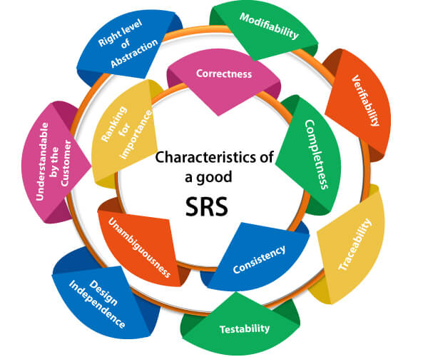

Slide 13
Characteristics of a Good SRS Document
Correctness : — SRS is said to be perfect if it covers all the needs that are truly expected from the system.
Completeness : — Contains all essential requirements, whether relating to goals & objectives, functionality, performance, design, constraints, attributes, or external interfaces. — Contains definition of responses of the software to all realizable classes of input data in all available categories of situations. — Involves all stakeholders

Slide 14
Characteristics of a Good SRS Document
Consistency : — The use of standard terms and definitions. — The consistent application of business rules in all functionalities.
Unambiguity : — Every fixed requirement has only one interpretation.
Modifiability : — Should be capable to quickly obtain changes to the system to some extent.

Slide 15
Characteristics of a Good SRS Document
Traceability : — The origin of each of the requirements is clear and it facilitates the referencing of each condition in future development.
Verifiability : — There exists some cost-effective process that can check whether the final product meets the requirements.
Testability : — Should be written in such a method that it is simple to generate test cases and test plans from the report.

Slide 16
Characteristics of a Good SRS Document
Comprehensibility : — Written in such a way that the customer understands.
Feasibility : — Confirmed on technical and operational feasibility.

Slide 17
https://www.geeksforgeeks.org/software-requirement-specification-srs-format/
https://www.javatpoint.com/software-requirement-specifications
References

